Slide 1
Parabole oko nas

Slide 2
Primeri 6 parabola: AKTIVNOST 1.

Slide 4
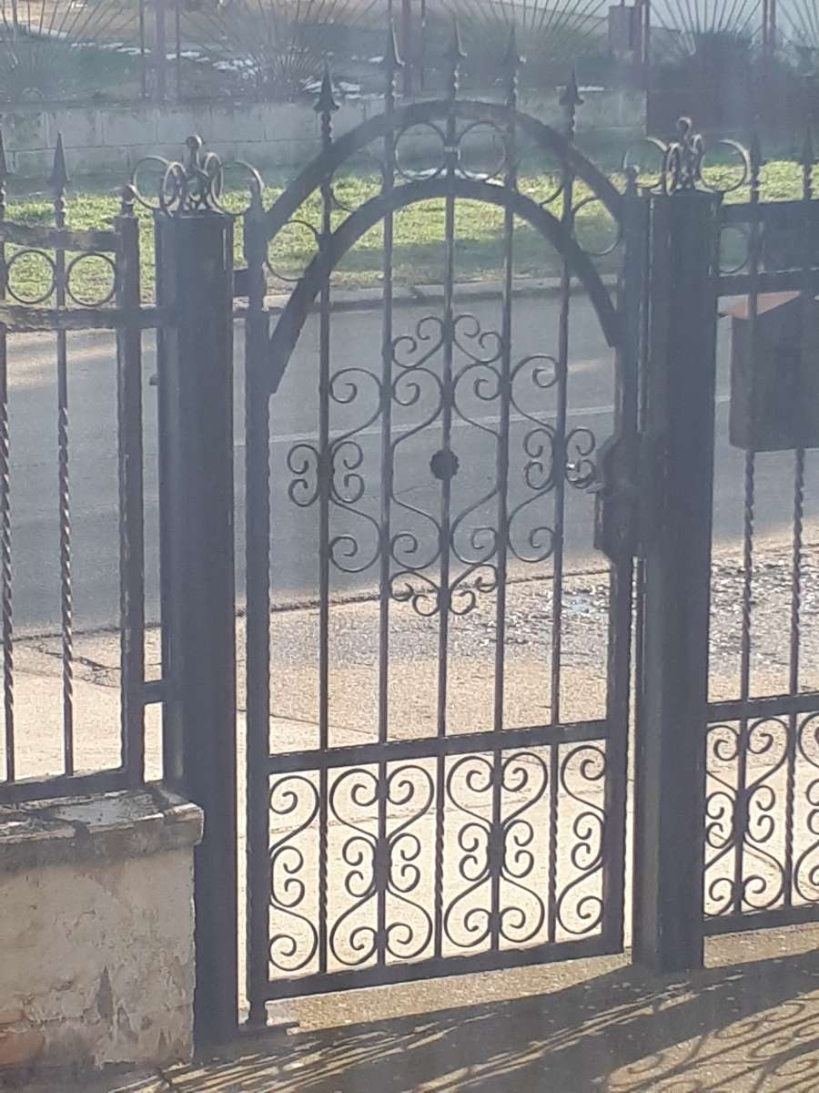
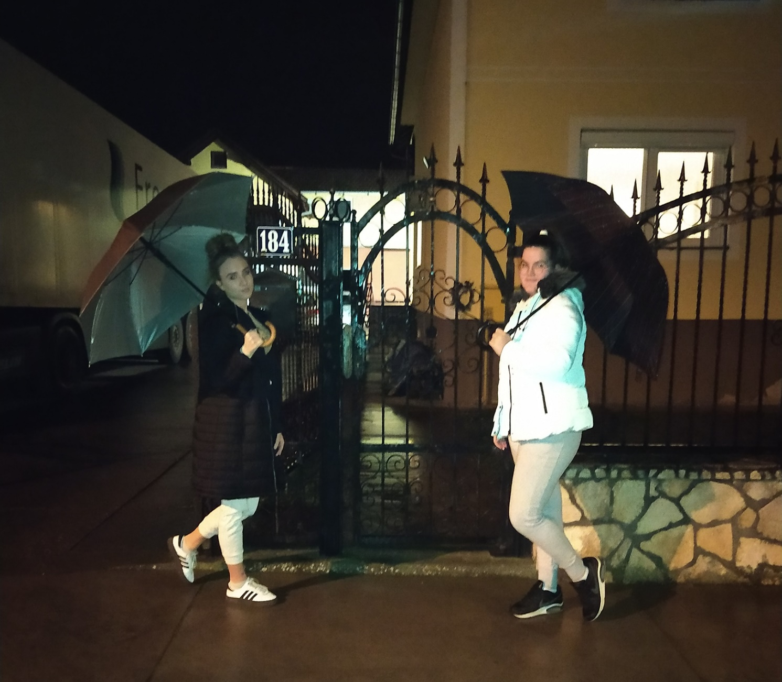

Slide 6
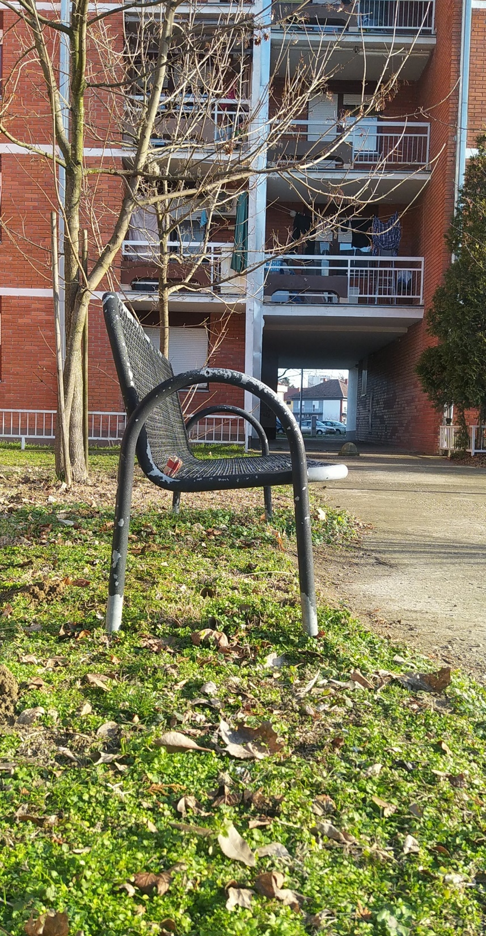

Slide 7
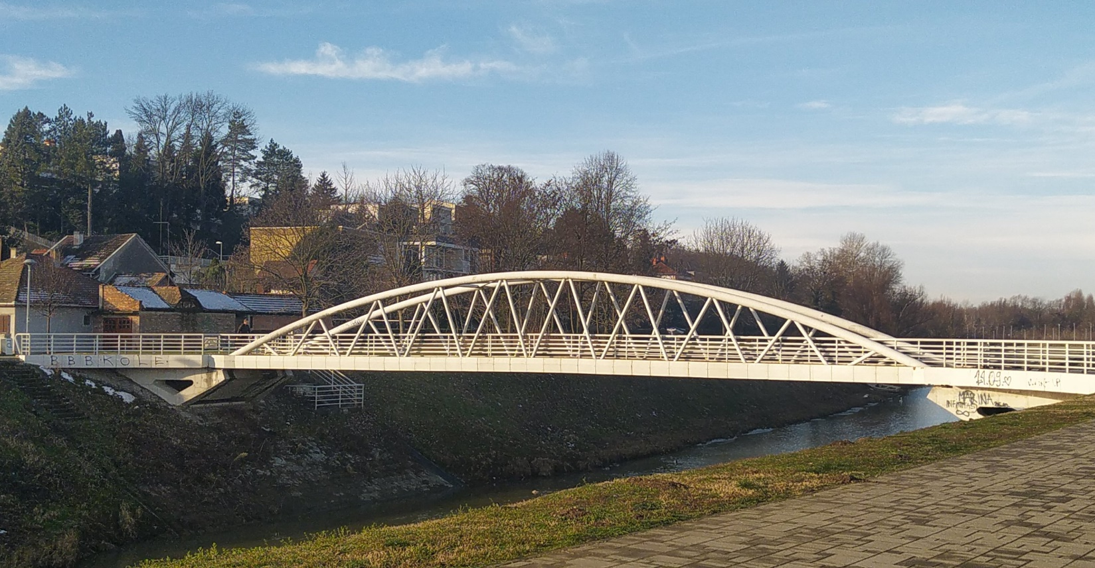

Slide 8
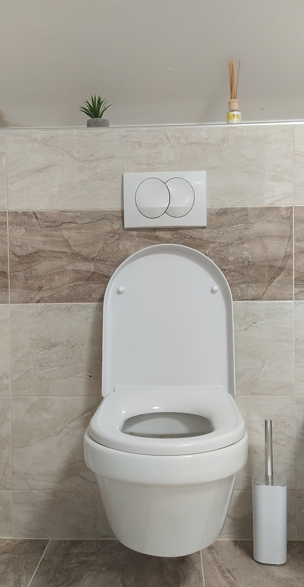

Slide 9
AKTIVNOST 2.

Slide 12
1.) f(x)=${ax}^{2}$+ bx + c
f(x)=${−1x}^{2}$ - 1.3x + 0.7
2.) f(x)=${−1x}^{2}$ - 1.3x + 0.7
a= -1
b= -1.3
c= 0.7
$x_{1,2}$=$\frac{−b ± \sqrt{b^{2}−4ac}}{2a}$
$x_{1,2}$=$\frac{−\left(−1.3\right)±\sqrt{{(−1.3)}^{2}−4∙(−1)∙0.7}}{2∙(−1)}$
$x_{1,2}$=$\frac{1.3 ± \sqrt{1.69+2.8}}{−2}$ = $\frac{1.3 ± \sqrt{4.49}}{−2}$ = $\frac{1.3±2.118}{−2}$
$x_{1}$= $\frac{1.3−2.118}{−2}=\frac{−0.818}{−2}=0.409$
$$x_{2}= \frac{1.3+2.118}{−2}=−\frac{3,418}{−2}=−1.709$$
4.) a=-1
b=-1.3
c=0.7
T(- $\frac{b}{2a}$ , $\frac{4ac − b^{2}}{4a}$)
- $\frac{b}{2a}=−\frac{−1.3}{2∙\left(−1\right)}=−\frac{13}{20}=−0.65$
$\frac{4ac−b^{2}}{4a}$= $\frac{4∙\left(−1\right)∙0.7−{(−1.3)}^{2}}{4∙(−1)}$=$\frac{449}{400}=1.1225 →1.12$
T(-0.65, 1.12)
max
$$N_{1}\left(0.409, 0\right)$$
$$N_{2}(−1.709, 0)$$

Slide 13
X -∞ -0.65 +∞
f(x) ↘ 1.12 ↗
5.)
˂-∞, -0.65>
<-0.65, +∞>
6.) D=$b^{2}−4ac$
D=${(−1.3)}^{2}−4∙\left(−1\right)∙0.7$
D=1.69 + 2.8
D= 4.49 > 0
Ako je D>0, jednačina ima dva različita realna rešenja.
3.) secište s ordinatom y = 0, 0.8

Slide 14
AKTIVNOST 3.

Slide 15
1.) f(x) > 0
x $ε <0.409, −1.709>$
2.) f(x) <0
$<−∞, 0.409>∪<−1.709, +∞>$
3.) f(x) $≥0$
1.1225→1.12
4.) f(x) $≤0$
1.1125→1.12

Slide 16
ALEKSANDRA RADOŠEVIĆ
&
TEODORA KOVAČEVIĆ
2a
27.1.2021.

